Slide 1
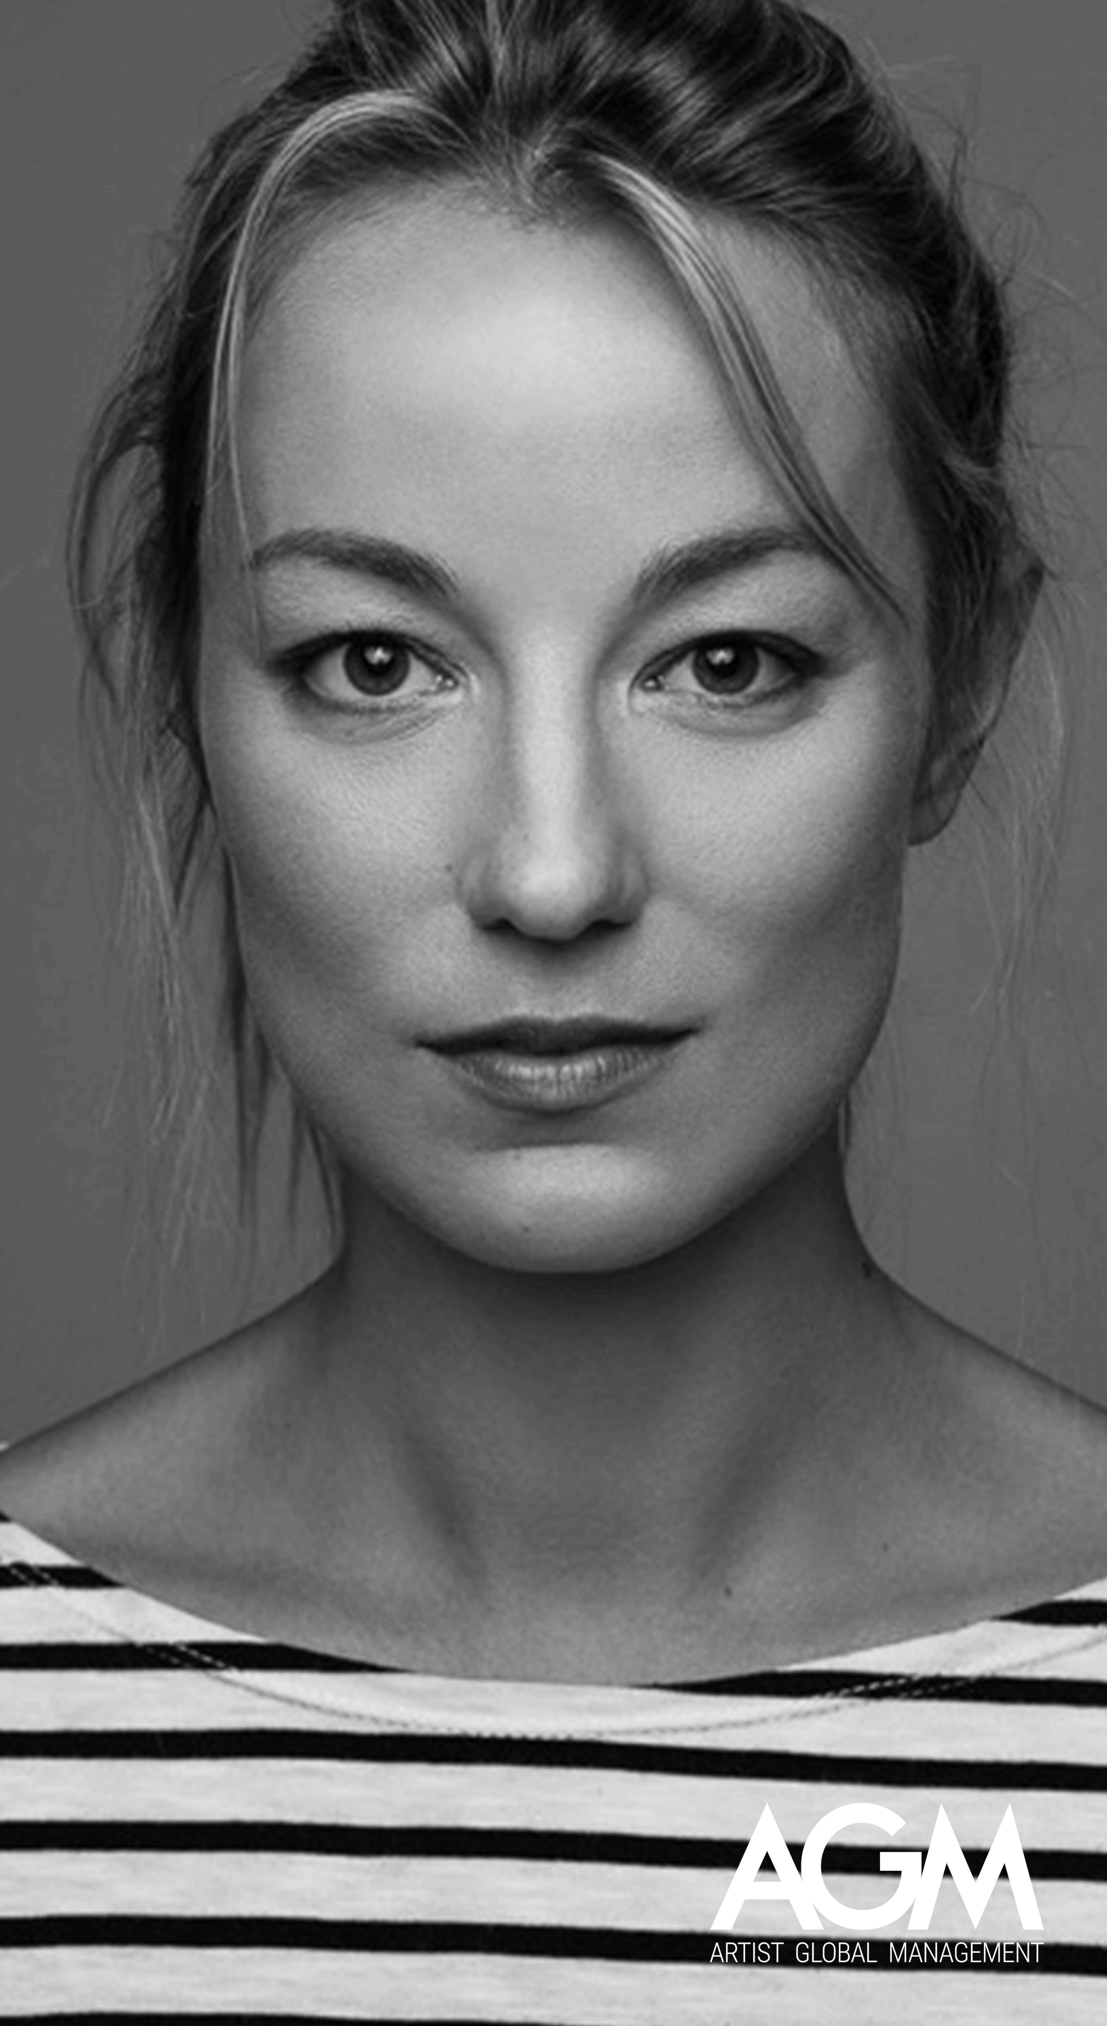
MAYA
BOOTH
CINEMA
2025, “Memórias de um Cárcere”, realização de Sérgio Graciano, Leopardo Filmes
2024, ”O Pior Homem de Londres”, Directed by Rodrigo Areias, Produced by Leopardo Filmes
2023, “Os Papéis do Inglês”, Directed by Sérgio Graciano, Produced by Leopardo Filmes
2021, ”Um Filme em forma de assim”, Directed by João Botelho, Produced by Ar de Filmes
2017, “Peregrinação”, Directed by João Botelho
2016, “Amor Amor", Directed by Jorge Cramez
2014, “The Hunchback”, Short, Directed by Gabriel Abrantes and Ben Rivers
2014, “Os Maias: Cenas da Vida Romântica”, Directed by João Botelho
2014, “Lisbon Revisited”, Directed by Edgar Pêra
2014, “Stillness”, Short, Directed by Edgar Pêra
2011, “Quinze Pontos na Alma”, Directed by Vicente Alves do Ó
2009, “Perpétua”, Directed by Marcos Filipe Albuquerque
2009, ”Oh Lisboa Meu Lar”, Documentary, Directed by João Botelho
2008, “Out Of The Blue”, Short, Directed by Simão Cayatte
2008, “A Corte do Norte”, Directed by João Botelho
2007, “The Blind Voyeur”, Short, Directed by Simão Cayatte
2006, “20, 13”, Directed by Joaquim Leitão
2005, “Fin de Curso”, Directed by Miguel Martí (Spain)
1997, "O Apartamento”, Short, Produced by Off
CONTACTS
(351) 218 288 574
agm@artistglobalmanagement.com
artistglobalmanagement.com
LANGUAGES
Portuguese and English
CHARACTERISTICS
  Eyes: Brown
Hair: Blonde
Height: 1,70m
SKILLS
  Dance

Slide 2
MAYA
BOOTH
THEATER
“FAZER, um alfabeto de aniversários”, text by Gertrude Stein, Staging by António Pires, Production Ar de Filmes, Teatro do Bairro
“The Bold Soprano”, Staging by João Telmo
“O Actor Imperfeito”, Staging by António Pires
“A Lenda de São Julião Hospitaleiro”, Staging by António Pires
“Say it with Flowers”, Staging by António Pires
“The Cherry Orchard”, Staging by Jonathan Weightman
“Dr. Jekyll and Mr. Hyde”, Staging by Keith Esher Davis
“A Midsummer Night’s Dream”, Staging by George Ritchie
“The Seagull”, Staging by Pat O’Tool
“As You Like It”, Staging by Miranda Kinsley
”The Good Person of Shichuan”, Staging by David Zoob
“Macbeth”, Staging by Gabriel Gawin
“Reality Show”, Staging by Derek Goldby
“The Music Lovers”, Staging by Derek Goldby
“Our Country’s Good”, Staging by Anna Linstrum
“Nothing Compares to You", Staging by Natalie Wilson
TELEVISION
2025, “Lost in Fuseta III”, realização de Holger Karsten Schmidt, 27 Lis
2024/2025, “A Fazenda”, Plural, TVI
2024, “Homens de Honra” Sky dreams, Sérgio Graciano
2024, “Morangos com Açúcar” - temporadas 5 e 6, See my Dreams, TVI e Prime Vídeo
2023, “Travessia”, série, Realização Fernando Vendrell, David & Golias, RTP
2022, “Abandonados”, TV Series, Production Francisco Manso, RTP1
2021/23, “Para Sempre”, Soap Opera, Plural, TVI
2020, “A Abóboda”, Television Film, Direction: Cláudia Clemente, Marginal Filmes, RTP
2020, “Quer o Destino”, Soap Opera, Plural, TVI
2018, “Verão M”, TV Series, Santa Rita Filmes and Skydreams Entertainment, RTP

Slide 3
MAYA
BOOTH
TELEVISION
2017/18, “A Herdeira”, Soap Opera, Plural, TVI
2017, “Madre Paula”, TV Series, Vende-se Filmes, RTP
2015/16, “A Impostora”, Soap Opera, Plural, TVI
2015, “Os Maias”, TV Series, Ar de Filmes, RTP
2014/15, “Jardins Proibidos”, Soap Opera, Plural, TVI
2012, “Dancin' Days”, Soap Opera, SP Televisão, SIC
2012, “Perdidamente Florbela”, TV Series, Ukbar Filmes, RTP
2011, “Maternidade”, TV Series, SP Televisão, RTP
2011, "Família Mata”, TV Series, Cinemate and SP Televisão, SIC
2011/12, “Voo Directo”, TV Series, SP Televisão and Semba Comunicação, RTP
2009/10, “Deixa Que te Leve”, Soap Opera, Plural, TVI
2009, “Sete Vidas”, TV Series, SIC
2008/09, “Feitiço de Amor”, Soap Opera, NBP and Plural, TVI
2008, “Nome de código: Sintra", TV Series, Filmes de Fundo, RTP
2007, “Floribella", Soap Opera, SIC
2006, “Aqui não há Quem Viva”, TV Series, Teresa Guilherme Produções, SIC
2005, "Dei-te Quase tudo”, Soap Opera, Fealmar and NBP, TVI
2005, “Inspector Max”, TV Series, Pipoca Entertainment, TVI
2001/02, “Filha do Mar”, Soap Opera, Fealmar and NBP, TVI
2001, “Jardins Proibidos”, Soap Opera, Fealmar and NBP, TVI
2000, “Almeida Garret”, TV Series, RTP

Slide 4
MAYA
BOOTH
DUBBING
Ready, Steady, Go (English Language Teaching Cassette)
Lusogef (English Language Teaching Cassette)
Texto Editora (English Language Teaching Cassette)
Constância Editores (English Language Teaching Cassette)
Grupo Fórum (English Language Teaching Cassette)
Constância Editores (English Language Teaching Cassette)
Portugal Telecom (International Promotion)
All Set Productions (Video presentation for the Euro 2004 inauguration)
EuroMillions, Advertising Spot, Indigo
TRAINING
2000/05, Degree in Representation, University of Rose Bruford College (United Kingdom)
1998, Acting Course, National Youth Theater (London)
1998, Dance, Royal Academy of Dance
1994/96, Dance, National Conservatory of Dance
TECHNIQUES ACQUIRED
Mimicry and Mask: Television Technique; Improvisation: Radio Technique; Stage combat; Canto (Mezzo); Historical Dance; Voice technique; Traditional Portuguese Dance

